Slide 1
Bengaluru Housing Dataset Overview
Presented by : -
Rohan Kumar -25GIBSPGDM086
Kamesh Samrit-25GIBSPGDM067
Arnav Mondal-25GIBSPGDM054
Jujan Kataky-25GIBSPGDM066

Slide 2
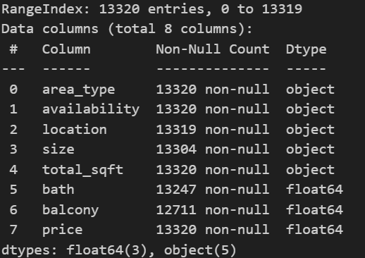
Exploratory Data Analysis(EDA)
Understand the Data - Basic EDA
Goal: Get a feel for your dataset
We checked that:
    Number of rows & columns = (13257, 10)
    Data types

Slide 3
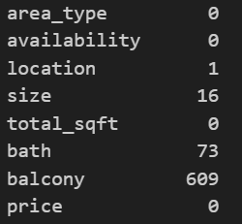
Missing values
A.Price vs Total Square Feet - Scatter Plot
What this visual shows
This scatter plot shows the relationship between house price and
total square feet.
Each dot represents one property.
What we learn
In general, larger homes tend to cost more, which means price
increases with size.
However, the points are spread out, meaning two homes with
similar size can have different prices.
This suggests location and features also influence price, not only
area.A few dots are very high - these are luxury or premium properties.

Slide 4
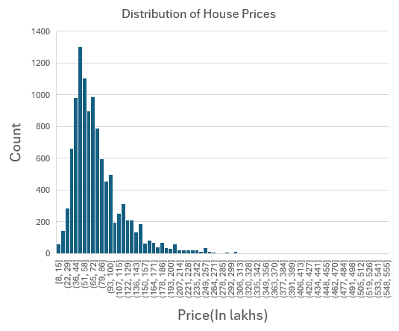
B. Distribution of House Prices -Histogram
What this visual shows
This chart shows how many properties fall into different price ranges.
What we learn
Most houses fall within the mid-range price brackets
36-44 lakhs.
Very expensive houses are fewer and form a small tail
of the distribution.
This means the housing market is skewed towards
affordable/mid-budget buyers with a smaller luxury segment.

Slide 5
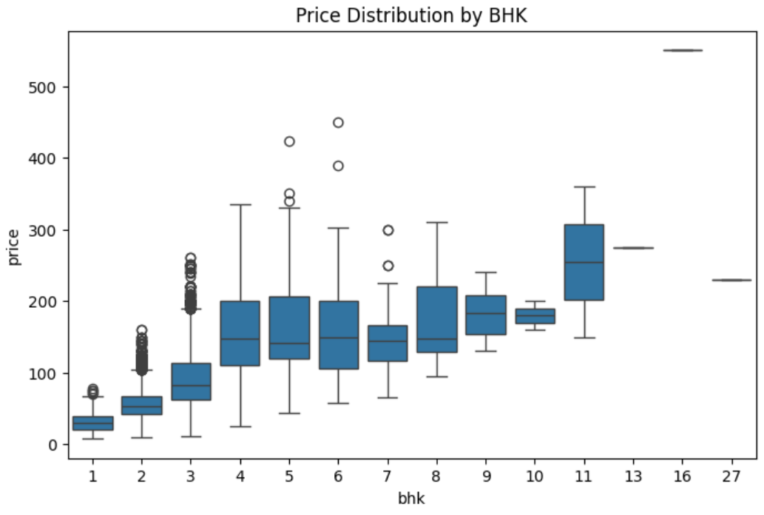
C. Price Distribution by BHK - Box Plot
What this visual shows
This box plot compares price across different BHK sizes.
What we learn
As BHK increases, the median price also increases - meaning
bigger homes cost more.
Price variation also increases for higher BHKs, showing luxury
and premium options exist mostly in higher-BHK homes.
There are some outliers -these are exceptionally expensive
properties within each BHK category.
This proves BHK count is an important factor influencing price.

Slide 6
D. Customer Preference Based on BHK - Bar Graph
Query :-
Select bhk,count(*) from bengaluru_housing_cleaned
group by bhk order by count(*) desc
LIMIT 10;
What this visual shows
This chart shows which BHK type has the highest number of listings - representing customer demand.
What we learn
2-BHK and 1-BHK homes are the most preferred
and common choices.
Very small units (4-BHK) and very large units
(4+ BHK) are less common.
This means the majority of buyers are small
to mid-size families or working professionals.

Slide 7
E. Customer Preference Based on Location - Clustered Bar Chart
Query : -
Select location,count(*) as customer_count
from bengaluru_housing_cleaned
group by location
Order by count(*) desc
Limit 10;
What this visual shows
This chart displays which locations have the highest number of properties.
What we learn
The top locations like Whitefield have the highest housing activity and demand.
These are likely popular residential hubs with better connectivity and facilities.
Locations with fewer properties may be niche or developing areas.
This gives a clear picture of where the market is most active.

Slide 8
F. Average Price by Location - Clustered Bar Chart
What this visual shows
This chart compares average house prices across different locations.
What we learn
Some locations have significantly higher average prices, indicating premium or upscale neighborhoods.
Other locations show moderate or lower average prices, suggesting budget-friendly or developing areas.
This helps identify premium zones vs value-for-money areas.

Slide 9
G. Average Price by Bathroom (Feature-Wise Comparison) - Clustered Column Chart
What this visual shows
This visual compares average house prices across different property characteristics.
What we learn
More bathrooms generally have higher average prices.
This helps identify which property attributes contribute more to pricing.
It supports decision-making for developers, buyers, and investors.
We can see that 16 bathrooms have very high average price that is
there should be an outlier.

